Slide 1
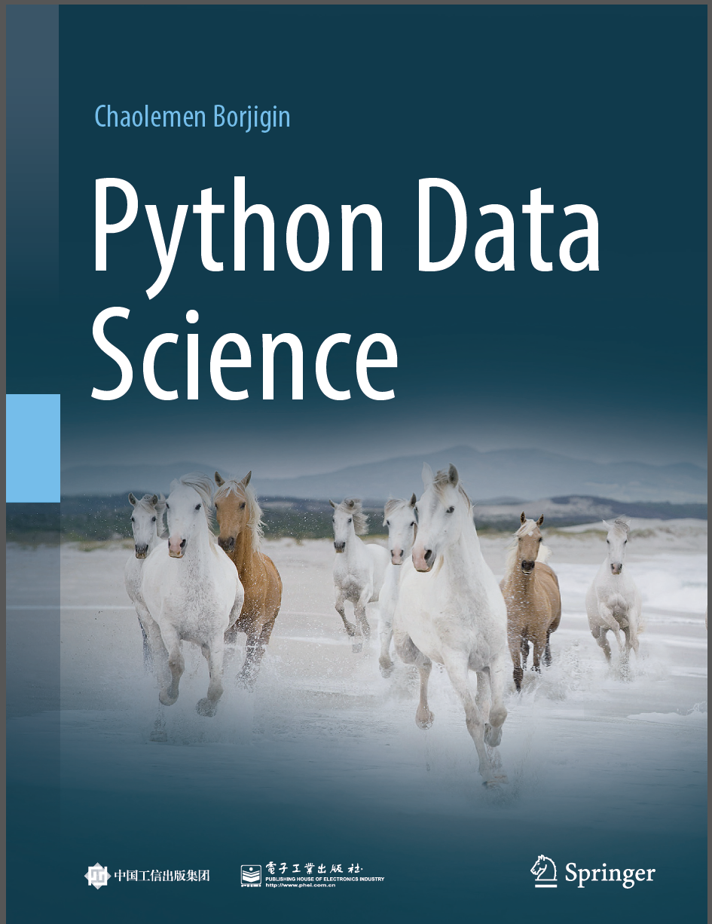
Python Data Science
Chaolemen Borjigin
Renmin University of China
chaolemen@ruc.edu.cn

Slide 2
2.8 For statements
▼ Chapter 2 Basic Python Programming for Data Science
► 2.8 For statements
Chaolemen Borjigin
Renmin University of China
chaolemen@ruc.edu.cn

Slide 3
Summary of this chapter
▼ Chapter 2 Basic Python Programming for Data Science
► 2.8 For statements
2.8.1 Basic syntax
2.8.2 The range( ) function
2.8.3 Advanced syntax

Slide 4
2.8.1 Basic syntax
▼ Chapter 2 Basic Python Programming for Data Science
►2.8 For statements
In[1]:
sum=0
for i in (1,2,3):
sum=sum+i
print(i,sum)
1 1
2 3
3 6

Slide 5
2.8.2 The range( ) function
▼ Chapter 2 Basic Python Programming for Data Science
►2.8 For statements
In[2]:
range(1,10)
Out[2]:
range(1, 10)
In[3]:
myList=list(range(1,10))
myList
Out[3]:
[1, 2, 3, 4, 5, 6, 7, 8, 9]

Slide 6
2.8.3 Advanced syntax
▼ Chapter 2 Basic Python Programming for Data Science
►2.8 For statements
In[4]:
sum=0
for i in (1,2,3):
sum=sum+i
print(i,sum)
else:
print("here is esle")
1 1
2 3
3 6
here is esle

Slide 7
2.8.3 Advanced syntax
▼ Chapter 2 Basic Python Programming for Data Science
►2.8 For statements
In[5]:
myList=list(range(1,10))
for j in [1,3,4,5]:
print(myList[j])
2
4
5
6

Slide 8
2.8.3 Advanced syntax
▼ Chapter 2 Basic Python Programming for Data Science
►2.8 For statements
In[6]:
for k in range(0,16,2):
if(k==8):
break
print(k)
0
2
4
6

Slide 9
2.8.3 Advanced syntax
▼ Chapter 2 Basic Python Programming for Data Science
►2.8 For statements
In[7]:
for k in range(0,16,2):
if(k==8):
continue
print(k)
0
2
4
6
10
12
14

Slide 10


